Slide 1
Summary
Sr.No. | Problem Char | Chess | Water-Jug | 8 Puzzle | Travelling Salesman | Tower of Hanoi | Bridge
1 | Decomposable | No | No | No | No | No | No
2 | Ignored /Undone | No | Yes | Yes | Yes | Yes | No
3 | Universe predictable | Yes | Yes | Yes | Yes | Yes | No
4 | Absolute/Relative | Any Path | Any Path | Any Path | Best | Any | Any
5 | State/ Path | State | Path | Path | Path | Path | Path
6 | Knowledge Required | Yes | Yes | Yes | Yes | Yes | Yes
7 | User Interaction | Yes | No | No | No | No | Yes

Slide 2
Heuristic Search Methods
BFS
DFS
Generate And Test
Hill Climbing
Best First
Problem Reduction
Constraint Satisfaction
Mean Ends Analysis

Slide 3
Search Strategies: Blind Search
Breadth-first search
Expand all the nodes of
one level first.
Depth-first search
Expand one of the nodes at
the deepest level.

Slide 4
BFS
Root node is expanded first.
Then all the successors of the root are expanded next.
And then their successors and so on.

Slide 5
Search Strategies
(0, 0)
(4, 0)
(0, 3)
(4, 3)
(0, 0)
(1, 3)
(4, 3)
(0, 0)
(3, 0)

Slide 6
Breadth-first search
The End
Algorithm BFS:
  Create a variable called NODE-LIST and set it to the initial state.
  Until a goal state is found or NODE-LIST is empty do:
    Remove the first element from NODE-LIST and call it E. If NODE-LIST was empty, quit.
    For each way that each rule can match the state described in E do:
        Apply the rule to generate a new state.
        If the new state is a goal state, quit and return this state.
        Otherwise, add the new state to the end of NODE-LIST.

Slide 7
Depth-first search
The End
Algorithm DFS:
  If the initial state is a goal state, quit and return success.
  Otherwise, do the following until success or failure is signaled:
    Generate a successor, E, of the initial state. If there are no more successors, signal failure.
    Call Depth-First Search with E as the initial state.
    If success is returned, signal success. Otherwise continue in this loop.

Slide 8
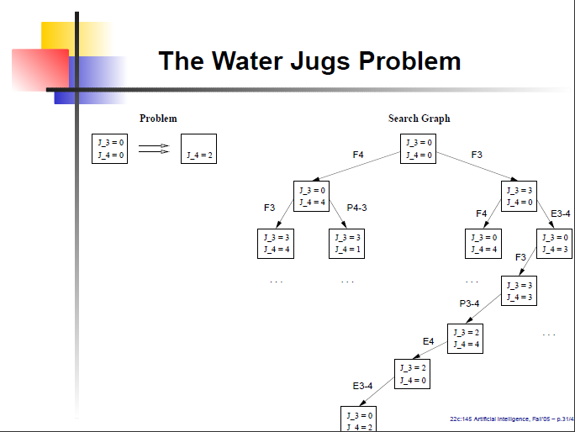
Continue this process until some rule produces a goal state.

Slide 9
Advantage BFS
The End
  1. Will not get trapped exploring blindly.
2. If there is a solution, then BFS is guaranteed to
find it.
3. If there are multiple solutions then a minimal
solution will be found.

Slide 10
Advantage DFS
The End
  Requires less memory.
  May find a solution without examining much of the search space.

Slide 11
Search Strategies: Blind Search
Criterion | Breadth-First | Depth-First
Time | b^{d} | b^{m}
Space | b^{d} | bm
Optimal? | Yes | No
Complete? | Yes | No
b: branching factor d: solution depth m: maximum depth

Slide 12
Generate And Test
1. Generate A possible Solution
For some problems, this means generating a particular point in the problem space i.e Generating a path from a start state.
2. Test to see if this Actually a Solution by compairing the chosen point or the endpoint of the chosen path to the set of acceptable goal states.
3. If a solution has been found QUIT
Otherwise return to step-1
Exa. Throwing a die to get particular score(6)
1
6
3

Slide 13
Generate And Test
1. It is Depth first Search procedure since complete solution must be generated before they can be generated
2. Exhaustive Search
3. It is also known as British Museum algorithm
(Finding an object in the museum randomly.)
4. ==DFS with Backtracking.

Slide 14
Hill Climbing
The End
    Similar to generate-and-test
    Feedback from the test procedure is used to help the generator, decides which direction to move in the search space.
    In pure generate & test procedure the test function responds only Yes or No.
    It is augmented with heuristic functions→how close a given state is to goal state.

Slide 15
Simple Hill Climbing
The End
    Evaluate the initial state. If it is a goal state ,return & Quit else continue with initial state as the current state.
    Loop until a solution is found or until there are no operators left to be applied in the current state.
    a) Select an operator that has not yet been applied to the
    current state and apply it to produce a new state
    b) Evaluate a New State
    i) If it is a goal state then return it & quit
    ii) If it is not a goal state, but it is better than the
    current state then make it the current state.
    iii) If it is not better than the current state,…then continue in the loop.
EXA. Water jug problem by path

Slide 16
Simple Hill Climbing
At each point in the search path, a successor node that appears to lead most quick to the goal is selected for exploration.
Hill climbing is like Depth first Search where the most promising child is selected for expansion to get goal state.
(or near to goal state.)

Slide 17
Steepest-Ascent Hill Climbing
The End
    Consider all moves from the current state
    Select the best one as the next state
    Algorithm page 67....

Slide 18
Steepest-Ascent Hill Climbing
1.Evaluate the initial state.If it is also a goal state, then return it & quit.
Otherwise continue with the initial state as the current state.
2. Loop until a solution is found or until a complete iteration produce no change to the current state.
a) Let SUCC be a state such that any possible successor of the current state will be better than succ.
b) For each operator that applies to the current state do:
i)Apply the operator & Generate new state.
ii)Evaluate new state..If it is a goal state then return &
quit.If not ,compare it to SUCC.If it is better,then set
SUCC to this state.If not Then leave SUCC alone.
iii)If SUCC is better than current state,then set current
state to SUCC.

Slide 19
A water jug solution
4-Gallon Jug 3-Gallon Jug Rule Applied
0 0
0 3 2
3 0 9
3 3 2
4 2 7
0 2 5 or 12 2 0 9 or 11
Solution : path / plan

Slide 20
Solution-2
Rules Applied--??
(0, 0)
(4, 0)
(1, 3)
(1, 0)
(0, 1)
(4, 1)
(2, 3)

Slide 21
Best First Search
It combines the advantages of DFS & BFS
DFS:-It allows solution to be found w/o all competing branches being expanded.
BFS:-It does not get trapped on dead end paths.
Follow a single path at a time, but switch path s whenever some competing paths looks more promising than the current one.
We have to apply appropriate Heuristic Function.
The old branch is not forgotten.

Slide 22
Best First Search
At each step of the BFS process
1)Select the most promising of the nodes we have generated so far.
2)Then expand the chosen node by using the rules to generate its successors
If one of them is a solution then quit.
3)If not all those new nodes are added to the set of nodes generated so far.
4)Again the most promising node is selected and the process continues.

Slide 23
OR Graph
If each of the branches represent an alternative problem solving path it is called as OR Graph.
In place of using search tree,it uses the search graph called as OR graph.
Each node of the graph contains a description of the problem state.

Slide 24
Step-2
Step-1
A
A
A
A
A
(3) (5) (1)

Slide 25
Step-3
Step-4
A
A
B
C
D
B
C
D
(3) (5)
(5)
E
F
G
H
E
F
(4) (6)
(6) (5)
(4) (6)

Slide 26
Step-5
A
B
C
D
(5)
G
H
E
F
(6) (5)
(4) (6)
I
J
(2) (1)

Slide 27
Lists Required?
OPEN:-Nodes that have been generated and have had the heuristic function applied to them but which have not been examined.
(Visited, but not expanded)
CLOSED:-nodes that have already been examined.
(Visited, expanded)

Slide 28
Algorithm :-Best First Search
1.Start with OPEN containing just the initial state.
2.Until a goal is found or there are no nodes left on OPEN do:
Pick them best node on OPEN
Generate its successor.
For each successor do:
(i) If it has not been generated before. evaluate it. add it to OPEN, and record its parent.
(ii) If it has been generated before, change the parent if this new path is better than the previous one.
in that case update the cost of getting to this node and to any successors that this node may already have.
EXA. Travelling Salesman Problem.

Slide 29
Heuristics: Example
71
 | Oradea
 | Neamt
 | Zerind
87
 | Iasi
75
151
92
 | Arad
 | Vaslui
140
99
 | Fagaras
 | Sibiu
118
142
220
211
98
 | Timisoara
 | Rimnicu Vilcea
85
 | Urziceni
 | Hirsova
111
 | Lugoj
97
 | Pitesti
70
101
 | Bucharest
146
86
 | Mehadia
138
90
75
 | Dobreta
 | Giurgiu
120
 | Craiova

Slide 30
Notations.
F’-Heuristic function to be used
g-measure of the cost of getting from the initial state to the current node.
h’ –Estimate of the additional cost of getting from the current node to the goal state.
F’(x)=g(x)+h(x)

Slide 31
A* Algorithm
1.Place the starting node S on open.
2.If open is empty, Stop & return failure.
3.Remove from open the node n that has the smallest value of f*(n).
If the node is a goal node, return success & Stop. Otherwise.
4. Expand n, generating all of its successor n’ and place n on closed.
For every successor n’, if n’ is not already on open or closed attach a back-pointer to n, Compute f*(n’) and place it on open.
5.Each n’ that is already on open or closed should be attached to back-pointers which reflect the lowest g*(n’) path. If n’ was on closed and its pointer was changed, remove it and place it on open.
6.Return to step 2

Slide 32
Heuristics: Example
Travel: h(n) = distance(n, goal)
71
 | Oradea (380)
 | Neamt (234)
 | Zerind (374)
87
 | Iasi (226)
75
151
92
 | Arad (366)
 | Vaslui (199)
140
99
 | Fagaras (176)
 | Sibiu (253)
118
142
220
211
98
 | Timisoara (329)
 | Rimnicu Vilcea (193)
85
 | Urziceni (80)
 | Hirsova (151)
111
 | Lugoj (244)
97
 | Pitesti (98)
70
101
 | Bucharest (0)
146
86
 | Mehadia
138
90
75
 | Dobreta (242)
 | Giurgiu (77)
 | Eforie (161)
120
 | Craiova (160)

Slide 33
Problem Characteristics
To choose an appropriate method for a
particular problem:
Is the problem decomposable?
Can solution steps be ignored or undone?
Is the universe predictable?
Is a good solution absolute or relative?
Is the solution a state or a path?
What is the role of knowledge?
Does the task require human-interaction?

Slide 34
1) Is the problem decomposable?
Can the problem be broken down to smaller problems to be solved independently?
Decomposable problem can be solved easily.

Slide 35
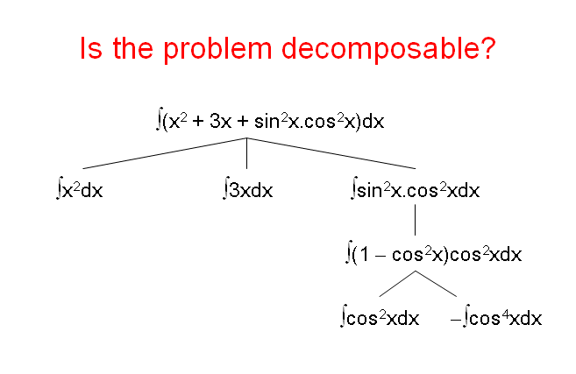
Symbolic Integration
∫ ½(1+cos2X)dx

Slide 36
Is the problem decomposable?
CLEAR(x) → ON(x, Table)
CLEAR(x) and CLEAR(y) → ON(x, y)
Start
Goal
A
ON(B,C)
ON(A,B)
C
B
A
B
C
Blocks World

Slide 37
Is the problem decomposable?
ON(B, C) and ON(A, B)
ON(B, C)
ON(A, B)
CLEAR(A)
ON(A, B)
A
C
B
A
B
C

Slide 38
2)Can solution steps be ignored or undone?
Theorem Proving
A lemma that has been proved can be ignored for next steps.
Ignorable!

Slide 39
Can solution steps be ignored or undone?
The 8-Puzzle
Moves can be undone and backtracked.
Recoverable!
2 | 8 | 3
1 | 6 | 4
7 |  | 5
1 | 2 | 3
8 |  | 4
7 | 6 | 5

Slide 40
Can solution steps be ignored or undone?
Playing Chess
Moves cannot be retracted.
Irrecoverable!

Slide 41
Can solution steps be ignored or undone?
Ignorable problems can be solved using a simple control structure that never backtracks.
Recoverable problems can be solved using backtracking.
Irrecoverable problems can be solved by recoverable style methods via planning.

Slide 42
3) Is the universe predictable?
The 8-Puzzle
Every time we make a move, we
know exactly what will happen.
Certain outcome!

Slide 43
Is the universe predictable?
Playing Bridge
We cannot know exactly where all the cards are or what
the other players will do on their turns.
Uncertain outcome!

Slide 44
Is the universe predictable?
For certain-outcome problems, planning can used to generate a sequence of operators that is guaranteed to lead to a solution.
For uncertain-outcome problems, a sequence of generated operators can only have a good probability of leading to a solution.
Plan revision is made as the plan is carried out and the necessary feedback is provided.

Slide 45
4)Is a good solution absolute or relative?
Marcus was a man.
2. Marcus was a Pompeian.
3. Marcus was born in 40 A.D.
4. All men are mortal.
5. All Pompeians died when the volcano
erupted in 79 A.D.
6. No mortal lives longer than 150 years.
7. It is now 2004 A.D.

Slide 46
Is a good solution absolute or relative?
Marcus was a man.
2. Marcus was a Pompeian.
3. Marcus was born in 40 A.D.
4. All men are mortal.
5. All Pompeians died when the volcano
erupted in 79 A.D.
6. No mortal lives longer than 150 years.
7. It is now 2004 A.D.
Is Marcus alive?

Slide 47
Is a good solution absolute or relative?
Marcus was a man.
2. Marcus was a Pompeian.
3. Marcus was born in 40 A.D.
4. All men are mortal.
5. All Pompeians died when the volcano
erupted in 79 A.D.
6. No mortal lives longer than 150 years.
7. It is now 2009 A.D.
Is Marcus alive?
Different reasoning paths lead to the answer. It does not
matter which path we follow.

Slide 48
Solution 1
The End
1. Marcus was man. axiom 1
4. All men are mortal. axiom 4
8. Marcus is mortal. 1,4
3. Marcus was born in 40 A.D. axiom 3
7. It is now 2009 A.D. axiom 7
9. Marcus’ age is 1961 years. 3,7
6. No mortal lives longer than 150 years axiom 6
10. Marcus is dead. 8,6,9

Slide 49
Solution 2
The End
7. It is now 2009 A.D. axiom 7
5. All Pompeians died in 79 A.D. axiom 5
11. All Pompeians are dead now. 7,5
2. Marcus was a Pompeian. axiom 2
12. Marcus is dead. 11,2

Slide 50
Is a good solution absolute or relative?
The Travelling Salesman Problem
We have to try all paths to find the shortest one.
 | Boston | New York | Miami | Dallas | Sanfransisco
Boston | - | 250 | 1450 | 1700 | 1300
New York | 250 | - | 1200 | 1500 | 2900
Miami | 1450 | 1200 | - | 1600 | 3300
Dallas | 1700 | 1500 | 1600 | - | 1700
Sanfransisco | 3000 | 2900 | 3300 | 1700 | -

Slide 51
Is a good solution absolute or relative?
Any-path problems can be solved using heuristics that suggest good paths to explore.
For best-path problems, much more exhaustive search will be performed.

Slide 52
5)Is the solution a state or a path?
Finding a consistent interpretation
“The bank president ate a dish of pasta salad with
the fork”.
  “bank” refers to a financial situation or to a side of a river?
  “dish” or “pasta salad” was eaten?
  Does “pasta salad” contain pasta, as “dog food” does not contain “dog”?
  Which part of the sentence does “with the fork” modify?
  What if “with vegetables” is there?
No record of the processing is necessary.

Slide 53
Is the solution a state or a path?
The Water Jug Problem
The path that leads to the goal must
be reported.

Slide 54
Is the solution a state or a path?
A path-solution problem can be reformulated as a state-solution problem by describing a state as a partial path to a solution.
The question is whether that is natural or not.

Slide 55
6) What is the role of knowledge
Playing Chess
Knowledge is important only to
constrain the search for a solution.
Reading Newspaper
Knowledge is required even to be able
to recognize a solution.
Exa-Cricket news(players)

Slide 56
7) Does the task require human-interaction?
Solitary problem, in which there is no intermediate communication and no demand for an explanation of the reasoning process.
Conversational problem, in which intermediate communication is to provide either additional assistance to the computer or additional information to the user.

